Slide 1

Facial Feature Localization
Prepared By:
Ayushi Vadwala
Jeet Shah

Slide 2
Problem Formulation
The aim of the project is to find the facial features on the gray scale images given as input. The output of the model will be the predicted value of the facial coordinates in (x, y) format which will help in placing the facial filter on the image.

Slide 3
Data Set
The dataset we are going to use is provided for Kaggle Competition
Our data set contains of a list of 7049 two-dimensional 8-bit gray level training images.
The images have their respective coordinates of the 15 facial key points
Facial Key points
Left eye center Left eye inner corner Left eye outer corner Left eyebrow inner end Left eyebrow outer end Mouth left corner Mouth center top lip Nose tip | Right eye center Right eye inner corner Right eye outer corner Right eyebrow inner end Right eyebrow outer end Mouth right corner Mouth center bottom lip

Slide 4
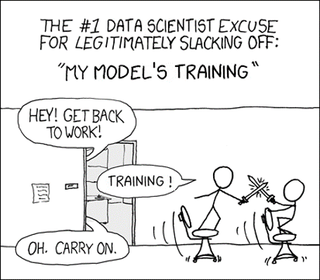
Data Set
The images are represented as a 96 × 96-pixel matrix. The matrix entries are integers from 0 through 255, characterizing the intensity of each of the 96 × 96 = 9216 pixels.
The training matrix is of size 7049 X 31.

Slide 5
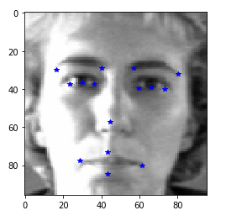
Sample Image

Slide 6

Plan
Convolutional Neural Network (CNN)
Transfer Learning (VGGFace2)
Cascaded Convolutional Neural Network
Applying Facial Filter with the help of predicted facial feature locations.

Slide 7
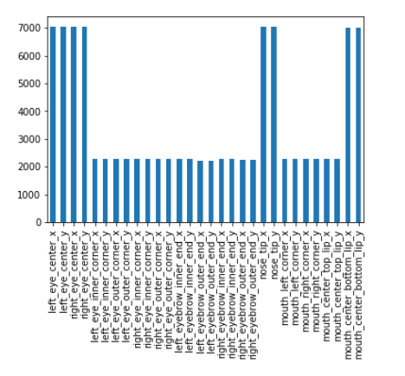
Pre-processing of the data
The statistics about the key point suggests that this dataset, only 2140 images are "high quality" with all keypoints, while 4909 other images are "low quality" with only 4 keypoints labelled which are the outliers.

Slide 8

We had to drop all the rows which had only 4 facial features

Slide 9
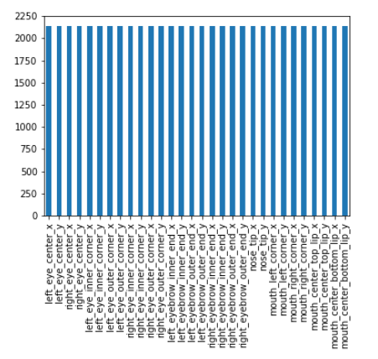
After removing outliers

Slide 10
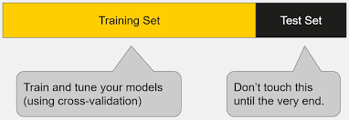
Train-test split on 2140 rows.
The train dataframe has 1712 images and test dataframe has 428 images.

Slide 11
Convolutional Neural Network
A Convolutional Neural Network (CNN) takes input as an image, assign importance to various aspects/objects in the image to differentiate one part from another.
The Convolution layer helps in reducing the image size for processing, so that the data which is critical for prediction is not lost.
The Pooling layer is responsible for reducing the spatial size of the Convolved Feature.
Pooling layer helps in decreasing the computational power requirement for data processing.

Slide 12
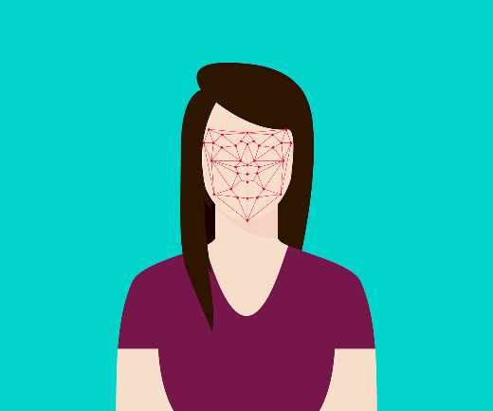
Convolutional Neural Network
Layer 1: Conv Filter = 32, Kernel size = (3,3), MaxPool = (2,2)
Layer 2: Conv Filter = 64, Kernel size = (3,3), MaxPool = (2,2)
Layer 3: Conv Filter = 128, Kernel size = (3,3), MaxPool = (2,2)
Layer 4: Conv Filter = 256, Kernel size = (3,3), MaxPool = (2,2)
Dense Layer: units = 500
Output Layer: units = 30

Slide 13
Convolutional Neural Network
Optimization | Kernel No | Kernel Size | Activation | R2 Score | RMSE
Adam | 32 | (3,3) | Relu | 0.46 | 2.22
 | 64 | (3,3) | Relu
 | 128 | (3,3) | Relu
 | 256 | (3,3) | Relu
Adam | 32 | (2,2) | Relu | 0.37 | 2.3
 | 32 | (2,2) | Relu
 | 64 | (2,2) | Relu
 | 64 | (2,2) | Relu
sgd | 32 | (3,3) | Relu | NAN | NAN
 | 64 | (3,3) | Relu
 | 128 | (3,3) | Relu
 | 256 | (3,3) | Relu

Slide 14
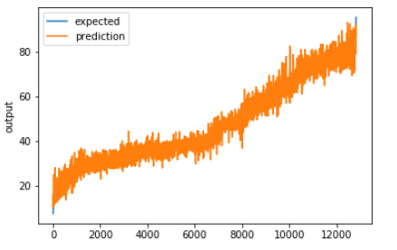
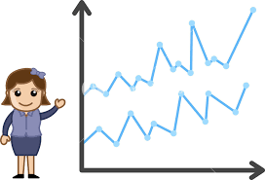
Convolutional Neural Network

Slide 15

Transfer Learning
Transfer learning is a machine learning method where a model developed for some task is reused as a starting point for another task. Transfer learning is used to accelerate the training and improve the performance of the deep learning model.

Slide 16
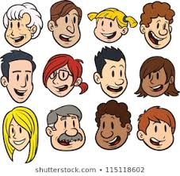
Transfer Learning - VGGFace 2
VGGFace 2 is a pre trained model on face recognition. The dataset contains 3.31 million images of 9131 subjects.
Images are downloaded from Google Image Search and has large variations in pose, age, illumination, ethnicity and profession.
The whole dataset is split to a training set (including 8631 identities) and a test set (including 500 identities).

Slide 17
Transfer Learning - VGGFace 2
This library can be installed via pip:
sudo pip install git+https://github.com/rcmalli/keras-vggface.git
After successful installation, you should then see a message like the following:
Successfully installed keras-vggface-0.6
You can confirm that the library was installed correctly by querying the installed package:
pip show keras-vggface

Slide 18
Transfer Learning – VGGFace2
The model is trained on colored images. It takes input of size 224 x 224 x 3.
The shape of the image in the Kaggle dataset is 96 x 96 x 1. To use the VGGFace pretrained model we need to change the shape of data to the 224 x 224 x 3.
Once the shape of data is changed the data is ready for the VGG model.

Slide 19
Transfer learning
Transfer learning
Dense layers | Number of nodes | RMSE
2 | 1024,30 (125 epochs) | 6.63
2 | 1024,30 (10 epochs) | 7.69
1 | 30 (50 epochs) | 9.72

Slide 20
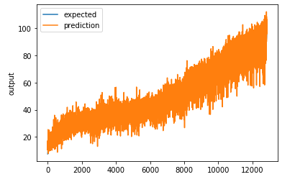
Transfer learning

Slide 21
Cascaded Convolutional Neural Network
The cascaded convolutional neural network has a Main network and four classification branches.
Here in the model we have used much less filters in comparison with CNN. As a result, the whole network is very light compared with a conventional network.

Slide 22
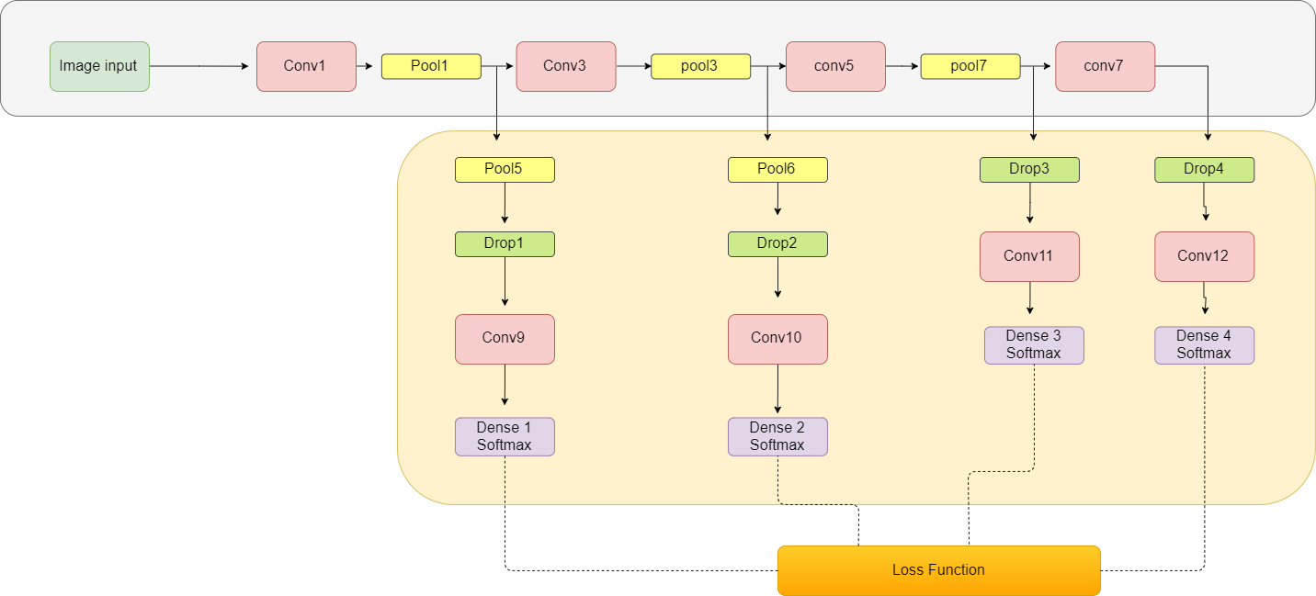
Cascaded Convolutional Neural Network

Slide 23
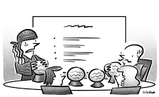
With the proposed convolutional network cascade for facial point detection on the first level highly robust initial estimations are provided, while shallower convolutional networks at the following levels finely tune the initial prediction to achieve high accuracy.

Slide 24
Cascaded Convolutional Neural Network
Main Network
Conv1 Filter = 64, Kernel size = 4
Pool1 = (2,2)
Conv3 Filter = 64, Kernel size = 4
Pool3 = (2,2)
Conv5 Filter = 32, Kernel size = 2
Pool7 = (2,2)
Conv7 Filter = 16, Kernel size = 4
Classification Branch
Pool5 = (2,2)
Drop1 = 0.25
Conv9 Filter = 32, Kernel size = 2
Dense1 = 20
Pool6 = (2,2)
Drop2 = 0.25
Conv10 Filter = 32, Kernel size = 4
Dense2 = 10
Drop3 = 0.25
Conv11 Filter = 16, Kernel size = 4
Dense3 = 10
Drop4 = 0.25
Conv12 Filter = 8, Kernel size = 4
Dense4 = 10

Slide 25
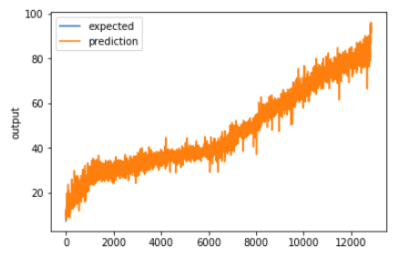
Cascaded Convolutional Neural Network
Best RMSE : 1.74
R2: 0.67

Slide 26

Facial Filters
One of the many applications of Facial Feature Detection is to apply facial filters on the image. Here for example we tried to place a moustache and a star on the facial image using location detected by our models.

Slide 27
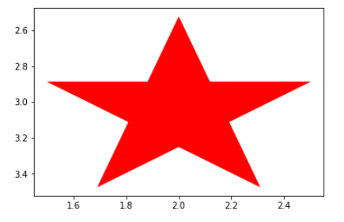
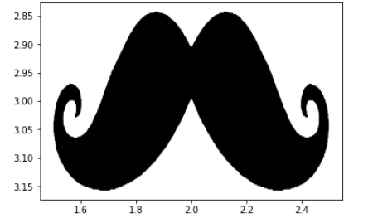
Facial Filters
Placing a star on the left eye of the image using the left eye centre key point
Placing a moustache on the upper lip using mouth center top lip key point

Slide 28

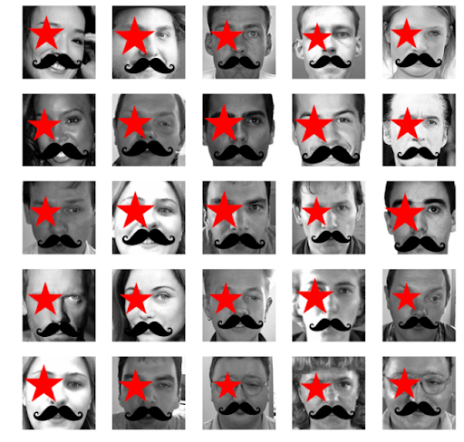
Facial filter applied

Slide 29

Result Analysis
Model | RMSE | R2
Convolutional Neural Network | 2.22 | 0.46
Transfer learning | 6.63 | -3.8
Cascaded Convolutional Neural Network | 1.74 | 0.67

Slide 30

Points To Think About
The negative transfer refers to scenarios where the transfer of knowledge from the source to the target does not lead to any improvement, but rather causes a drop in the overall performance of the target task.
There can be various reasons for negative transfer, such as cases when the source task is not sufficiently related to the target task, or if the transfer method could not leverage the relationship between the source and target tasks very well.

Slide 31
Points To Think About
Though Cascaded Convolutional Neural Network was trained for just 100 Epochs and Convolutional Neural Network for 500 Epochs, Cascaded Convolutional Neural Network is giving better results.
Cascaded Convolutional Neural Network is time efficient than Transfer Learning because to run just 1 Epoch Cascaded CNN was taking just 5 Seconds while Transfer Learning was taking 5 Minutes.
So, for this dataset Cascaded CNN is works best. It is time efficient model and gives great RMSE too!

Slide 32

WORK DIVISION
Name: Ayushi Vadwala
Tasks performed:
Removed rows with any null values and Removed duplicate rows
Feature Normalization
Implemented model (CNN) and Parameter Tuning for the same.
Transfer Learning and Cascaded CNN.
Worked on Report
Name: Jeet Shah
Tasks performed:
Split the data into train and test data.
Implemented facial filters
Transfer Learning and Cascaded CNN
Worked on presentation
Prediction for the Test data and compared actual and predicted result.

Slide 33
LEARNING EXPERIENCE
CNN is the state of the art, but it takes time in learning. The accuracy given by CNN is good.
In transfer learning a pre-trained model is trained on different images and it is taken as a starting point for the current model.
It is difficult to up sample the images from 96 x 96 to 224 x 224. For transfer learning the size of the images needs to be changed so that the pre-trained model can accept the images from our dataset.
Cascaded CNN gives surprising results. The RMSE and R2 score of the cascaded CNN is better than the CNN.
Any facial filters can be applied on the face if the facial feature location is known.

Slide 34
REFERENCES
Esmaeili, A., Khosravi, K., & Mirjalili, S. (2015). Facial Keypoint Detection.
https://www.kaggle.com/c/facial-keypoints-detection
Zhang, H., Chen, J., & Agarwal, N. Facial Keypoints Detection.
Sun, Y., Wang, X., & Tang, X. (2013). Deep convolutional network cascade for facial point detection. In Proceedings of the IEEE conference on computer vision and pattern recognition (pp. 3476-3483).
Longpre, S., & Sohmshetty, A. (2016). Facial Keypoint Detection.
Gao, R., & Liu, Q. (2018). Facial Keypoints Detection with Deep Learning. JCP, 13(12), 1403-1410.
Shi, S. (2017). Facial Keypoints Detection. arXiv preprint arXiv:1710.05279
https://towardsdatascience.com/a-comprehensive-guide-to-convolutional-neural-networks-the-eli5-way-3bd2b1164a53

Slide 35
Thank you ☺☺☺

